Slide 1


End to End Machine Learning pipeline
Bhavika Kanani
Founder, SoftmaxAI
India

Slide 2
What is Machine Learning?
It's sort of Artificial Intelligence that allows machine to learn, without being explicitly programmed.

Slide 3
Traditional Programming Vs Machine Learning
Traditional Programming is more like manually created program while in machine learning computer creates its own logic.
Rules
Answers
Traditional Programming
Answers
Machine
Learning
Rules
Data
Data

Slide 4
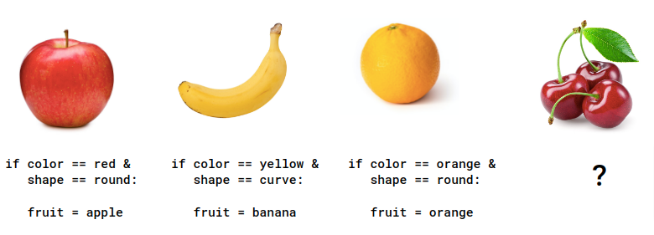
Fruit Recognition

Slide 5
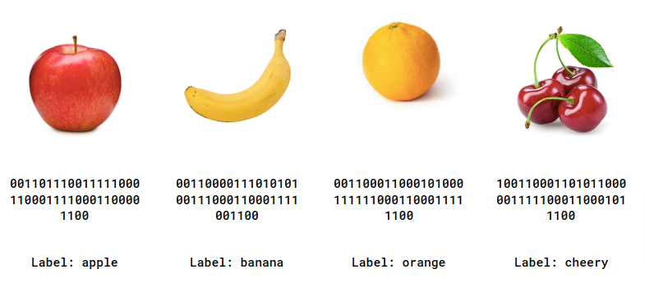
Fruit Recognition

Slide 6
The Machine Learning Paradigm
Make a Guess
Check the guess with actual label?
Optimize your
Guess

Slide 7
The Machine Learning Paradigm
Machine Learning
Model
labeled data
Predictions

Slide 8
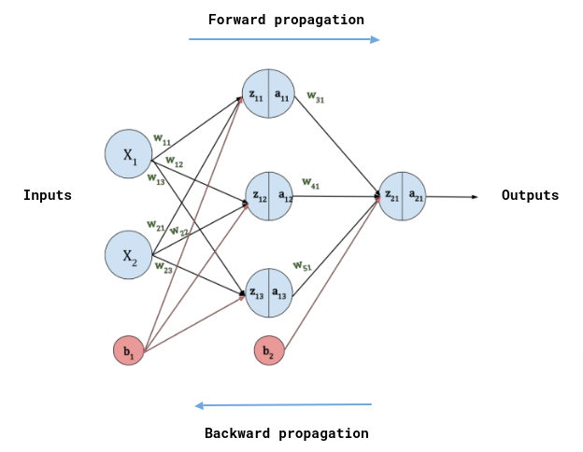
The Neural Network Architecture

Slide 9
Example
X = [-3, -2, -1, 0, 1, 2, 3]
Y = [-4, -2, 0, 2, 4, 6, 8]
Y = 2X + 2

Slide 10
Train the Model
from tensorflow import keras
model = keras.Sequential([keras.layers.Dense(units=1, input_shape=[1])])
model.compile(optimizer='sgd', loss='mean_squared_error')
xs = np.array([-3, -2, -1, 0, 1, 2, 3], dtype=float)
ys = np.array([-4, -2, 0, 2, 4, 6, 8], dtype=float)
model.fit(xs, ys, epochs=200)
model.predict([4.0])
Output: 9.964821

Slide 11
ML Pipeline

Slide 12
ML Lifecycle
- Acquire raw data
- Data Labelling
- Data Cleaning: Handle missing data and outliers
- Data Analysis: Inspect data
- Normalization the data
Data acquisition
Data preparation
Feature Engineering
- Build ML model
- Train the model
Model
Training
Model Deployment
Model
Evaluation
Hyper-parameters Optimization
- Deploy ML model to production
- Analyze the model performance on test dat
- Find the best set of parameters for the model

Slide 13
Data Preprocessing &
Feature Engineering

Slide 14
Data Preprocessing
Remove unwanted observation
Duplicate observation
Irrelevant observation
Handle imbalanced dataset
Handle outliers
Handle missing data

Slide 15
Handle missing data
Drop missing values
A Better Option: Imputation
Replace Missing Values by Constant Value, distinct from all other values like 0 or -999
Replace Missing Values by mean, mode or median value of the feature.
Replace by randomly selected value from feature.

Slide 16
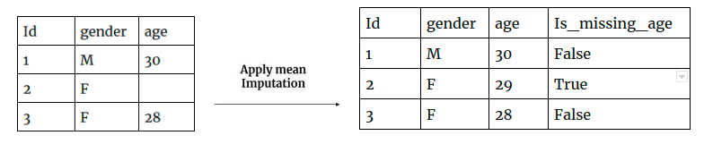
Handle missing data
Extension to Imputation

Slide 17
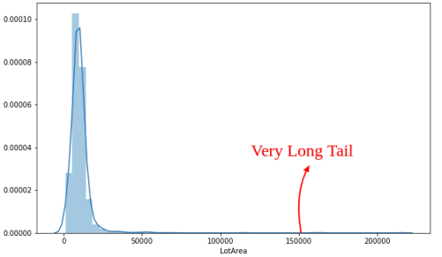
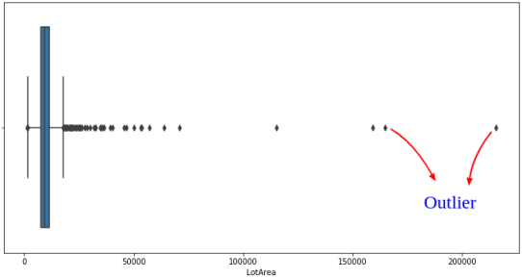
Handle outliers

Slide 18
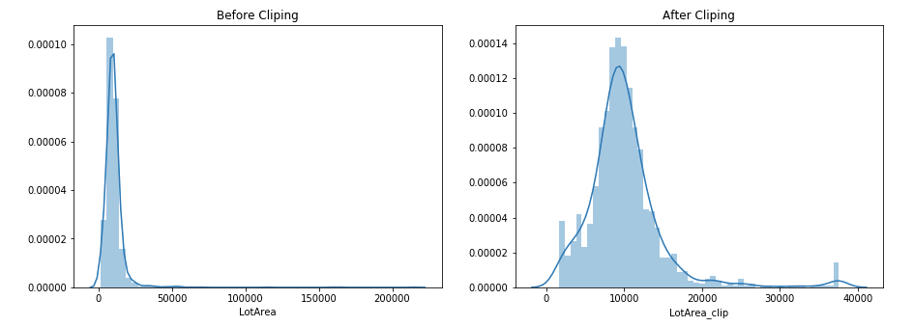
Handle Outliers: Winsorization
Clip feature values using the percentile of the feature values. (example: use data between 1st and 99th percentile)

Slide 19
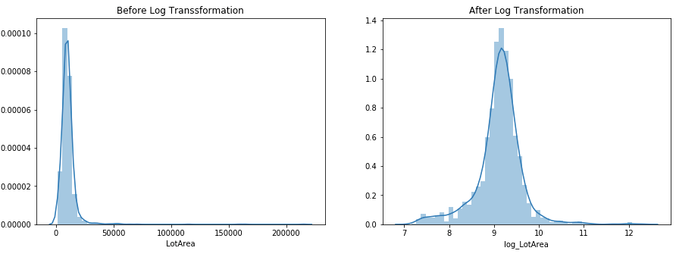
Handle Outliers: Log Transformation
A Log transformation drives too big values closer to the feature’s mean values.
train['log_LotArea'] = np.log(1+train['LotArea'])

Slide 20
Feature Engineering
Get domain knowledge
Exploratory data analysis (EDA)
Find the relation between two features

Slide 21
Feature Engineering
Feature Creation
Feature Transformations
Binning
Log Transform
One-hot encoding
Label encoding
Scaling & Normalization
Feature selection

Slide 22
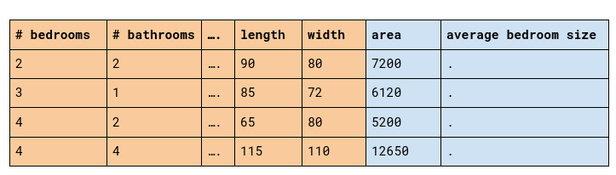
Feature Creation

Slide 23
Encoding categorical data
Nominal
A Categorical features which are only labelled without any order preference are called the Nominal features.
Ordinal
A Categorical feature which is associated with some Order is called the Ordinal feature.
Cyclical
The Categorical feature which happens in specific cycles is called a Cyclical feature.

Slide 24
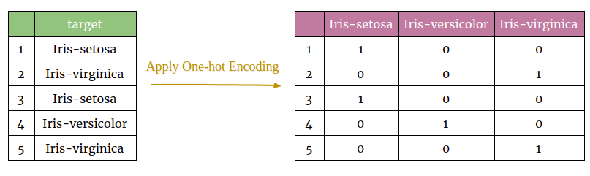
Encoding Nominal categorical data: one-hot encoding

Slide 25
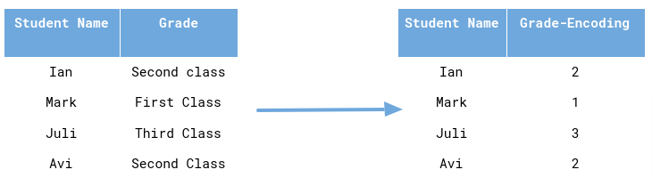
Encoding Ordinal categorical data: Label encoding

Slide 26
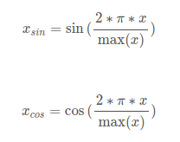
Encoding Cyclical categorical data
Day, month, the season is cyclic by nature. These all features happen in a specific cycle. Sine and Cosine transformation are used to encode the cyclical feature.
df['day_sin'] = np.sin(2 * np.pi * df['day_of_week']/7.0)
df['day_cos'] = np.cos(2 * np.pi * df['day_of_week']/7.0)

Slide 27
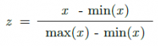
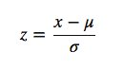
Feature Scaling
Scaling is the process of standardized features to the same scales.
MinMaxScaler: MinMaxScaler scales values between [0,1]
StandardScaler: Scale the data by setting the mean of the data 0 and the standard deviation to 1.

Slide 28
Feature Selection
Feature importance plot
Correlation Coefficient
Variance Threshold

Slide 29
Preparing Model

Slide 30
Preparing Model
Define Model Architecture
Compile the model
Fit model on train data
Evaluate model on test data
Make Predictions

Slide 31
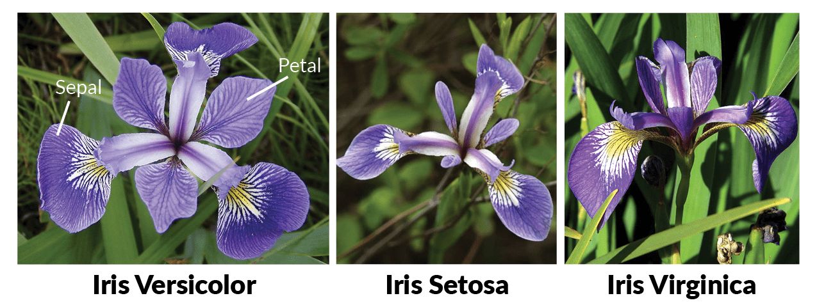
IRIS Dataset
The Iris flower data set is a multivariate data set as an example of linear discriminant analysis. It contains five columns such as Petal Length, Petal Width, Sepal Length, Sepal Width and Species Type.

Slide 32
Load the IRIS data
from sklearn.model_selection import train_test_split
from sklearn.preprocessing import OneHotEncoder
from sklearn.datasets import load_iris
# load the iris dataset
iris_data = load_iris()
# Prepare data
X = iris_data.data
y = iris_data.target.reshape(-1, 1)
# One Hot encode the class labels
encoder = OneHotEncoder(sparse=False)
y = encoder.fit_transform(y)
# Split the data for training and testing
X_train, X_test, y_train, y_test = train_test_split(X, y, test_size=0.20)

Slide 33
Define the Model
from tensorflow.keras.models import Sequential
from tensorflow.keras.optimizers import Adam
from tensorflow.keras.layers import Dense
# Build the model
model = Sequential()
model.add(Dense(10, input_shape=(4,), activation='relu'))
model.add(Dense(10, activation='relu'))
model.add(Dense(3, activation='softmax'))
print(model.summary())

Slide 34
Compile & Train the Model
# Adam optimizer with learning rate of 0.001
optimizer = Adam(lr=0.001)
model.compile(optimizer, loss='categorical_crossentropy', metrics=['accuracy'])
# Train the model
model.fit(X_train, y_train, batch_size=5, epochs=200)
# Evaluate the Model
results = model.evaluate(X_test, y_test)
print("Loss : ", results[0])
print("Accuracy : ", results[1])
Loss : 0.05525088682770729
Accuracy : 0.9666666388511658

Slide 35
Q/A

Slide 36
Question 1: Loss function for Regression problem
Mean Squared Error (MSE)
Mean Absolute Error (MAE)
Mean Squared Logarithmic Error Loss

Slide 37
Question 2: What is Activation functions?
The activation function allows the neural network to learn a non-linear pattern between inputs and target output variable.
There is mainly four activation function used in the neural network. That are listed below:
Sigmoid
Tanh – Hyperbolic tangent
ReLU – Rectified linear unit
Leaky ReLU

Slide 38
Question 3: What is Learning Rate in NN?
The learning rate is a hyperparameter that determines the step size at each training iteration while moving toward an optimum loss function.
new weight = old weight - (learning rate * gradient)

Slide 39
Question 4: what is back-propagation neural networks?
Backpropagation is the process of propagating the error(loss) back to the neural network and update the weights of each neuron subsequently by adjusting the weight and bias parameters.
The parameter updation is determined by finding the partial derivation of the loss function with respect to those parameters.

Slide 40
Question 5: What is Gradient Descent in NN?
Gradient Descent is an optimal algorithm to minimize the cost function for finding the local minimum of a function.

Slide 41
Thank You...

